Slide 1
Advanced Systems Analysis and Design Conducting Scrum Meetings SOFT 30121 L20 Presented By Nigel King ACMA CGMA PCM Nigel.King@ntu.ac.uk

Slide 2
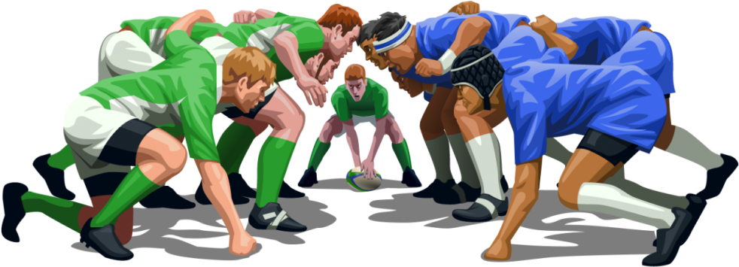
Conducting Scrum Meetings

Slide 3
The Big Picture
Constructing your sprint plan
Defining your teams’ definition of “done”.
Conducting Scrum Meetings
Conducting Reviews

Slide 4
Conducting Scrum Meetings
What is a scrum meeting?
Scrum meetings (sometimes called standups) are a daily check in from the scrum team members to review the work since the last scrum and plan the work until the next scrum.
It is facilitated by a Scrum Master. The scrum master is not:
The manager of the team
A project manager
The scrum master should be very good at keeping the team productive, removing obstacles and distractions. The scrum master should be really good at keeping proceedings within a time box.
It is briefly minuted, just to ensure that follow ups are done and people don’t use the meeting for things that should be done outside of standup.
The scrum meeting is for the members of the scrum team. That having been said the executive team at PowerSchool had an 08:30 standup every working day. We were the managers of a 400 million dollar company. The culture ran through the company.

Slide 5
Conducting Scrum Meetings
What is a scrum meeting not?
It is not s status meeting.
It is not a management briefing
It is not a review.
It is not a demo.
It is not an investigation.
It is not a teaching session.
It is not long
It is not boring
It is not dominated by any individual
It does not last longer than necessary

Slide 6
Conducting Scrum Meetings
Who should attend?
Engineers
Quality Assurance
User Interface Design
Scrum Master
Optional
Product Owner
At Powerschool we had a central pool of architects that reported to me. They were in very high demand, but could not attend every scrum meeting. They would attend those that they could. Architect is not a role that is formally recognized in scrum, but they tended to be good at breaking an impass, giving momentum, unblocking design problems. They were also very good at cross fertilizing between scrum teams.

Slide 7
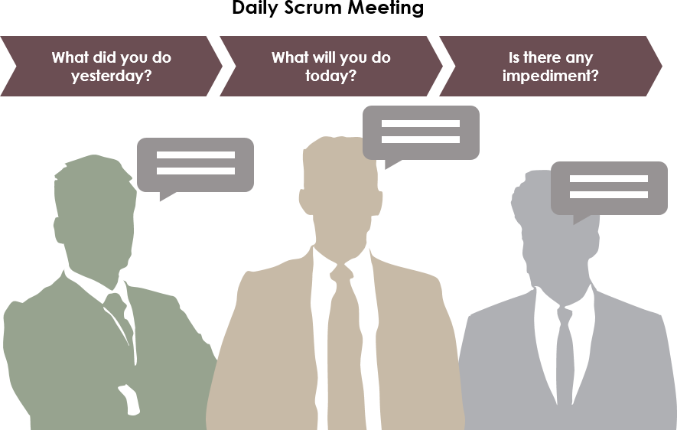
Conducting Scrum Meetings
What is on the agenda?
Everybody speaks.
Everybody listens.
What I have done since last standup
What I plan to do before next standup
Any obstacles that I am facing
If you are speaking for more than 2-3 minutes, something needs to be taken outside of the scrum meeting.

Slide 8
Conducting Scrum Meetings
What is a scrum board?
It is customary to have the scrum meeting somewhere that you can see the scrumboard.
The scrumboard is a simply visual planning board showing what is in the backlog, work is currently being worked on and what is Done.
Done means all tasks in the DOD are complete.
Given that there is a collective commitment to the sprint backlog, you should be able to see what is in work in progress so that you can help clear WIP rather than start something new from the sprint backlog.
The highest importance is in getting code shippable, so as you have capacity, help clear WIP. Have no more than 2 or 3 sprint backlog items in WIP.
Split out new tasks according to the definition of done, until the sprint backlog item can safely be put in the done column.
It is much better to have something to demo at the end of the sprint to start to confirm sprint velocity. Ending the sprint with everything in WIP is zero velocity.

Slide 9
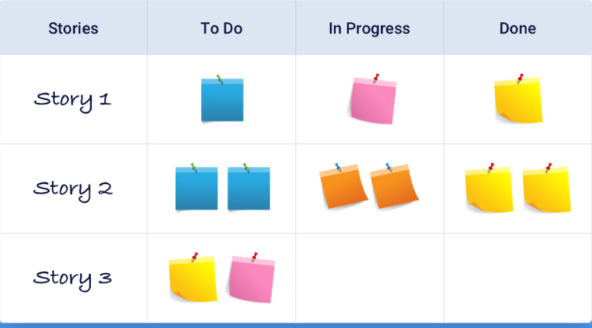
Conducting Scrum Meetings
What is a scrum board?

Slide 10
Conducting Scrum Meetings
How long should it last?
15 minutes is normal
10 minutes is good.
30 minutes means you do not understand how to run an agile team
30 minutes means you have an ineffective scrum master
30 minutes means that you are inviting inappropriate people to a scrum meeting.
30 minutes means that you have some personality issues in the team.
30 minutes means your development team has to factor out some productive time to attend a meeting

Slide 11
Conducting Scrum Meetings
What can go wrong?
People don’t arrive on time.
People don’t cant say what they did.
People don’t know what to pick up from the scrum board next.
People try to solve problems in the scrum meeting.
The wrong people are at the scrum meeting, so you start giving status or explaining the features.
A dominate personality wants to speak for too long.
People lose focus on the purpose of the scrum
The scrum team expand to fill a vacuum of time
Too many people get invited to the scrum
The scrum team is too big.
The people are nervous of each other and will not admit they are stuck
Follow ups are noted but not actioned

Slide 12

Scrum of Scrums
What is a Scrum of Scrums?
Scrum of scrums is a meeting with representatives of many scrum teams.
As a scrum team is the unit of productivity, as you scale there is some need to coordinate between scrum teams.
If lots of coordination is required, it probably means you have made an architectural mistake. Your applications are chatty and this is reflected in the need for coordination.

Slide 13
Scrum of Scrums
What is a Scrum of Scrums?
However, you will need to know that things are at least going to arrive together.
Management will be able to see pretty quickly what teams are moving and what teams are not.
The primary tool at Scrum of Scrums at Powerschool was the Burn Down Chart.

Slide 14
Scrum of Scrums
What is a Scrum of Scrums?
At Oracle the primary tool at the release meeting (an approximate analog), was the bug count, especially for those bugs marked as “Must Haves” for the release.
No-one wanted to be at the release management meeting, explaining why their “must have” bugs should slow up the release. The presumption is that a bug that is not “must have” in the release can be lived with until the next release. Product managers always push for more features and more fixes. Weak development managers accept the load and are then spinning chasing escaped bugs. Strong development managers push back strongly on product managers.

Slide 15
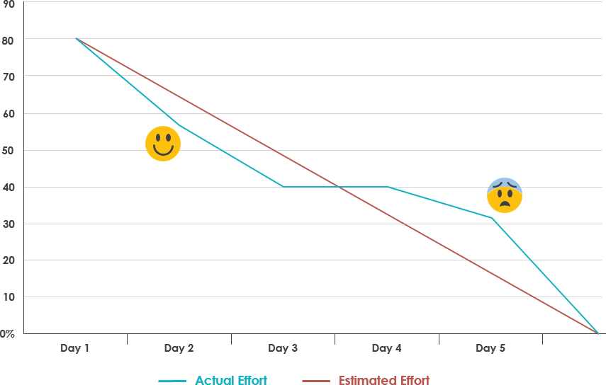
Scrum of Scrums
What is a burn down chart?
A burndown chart is a graphic representation of how quickly the team is working through a customer's user stories. The burndown chart shows the total effort against the amount of work for each iteration
I was used to seeing story points in the X-Axis. It is measuring how well the team predicts their progress. You cannot compare team to team very easily.

Slide 16
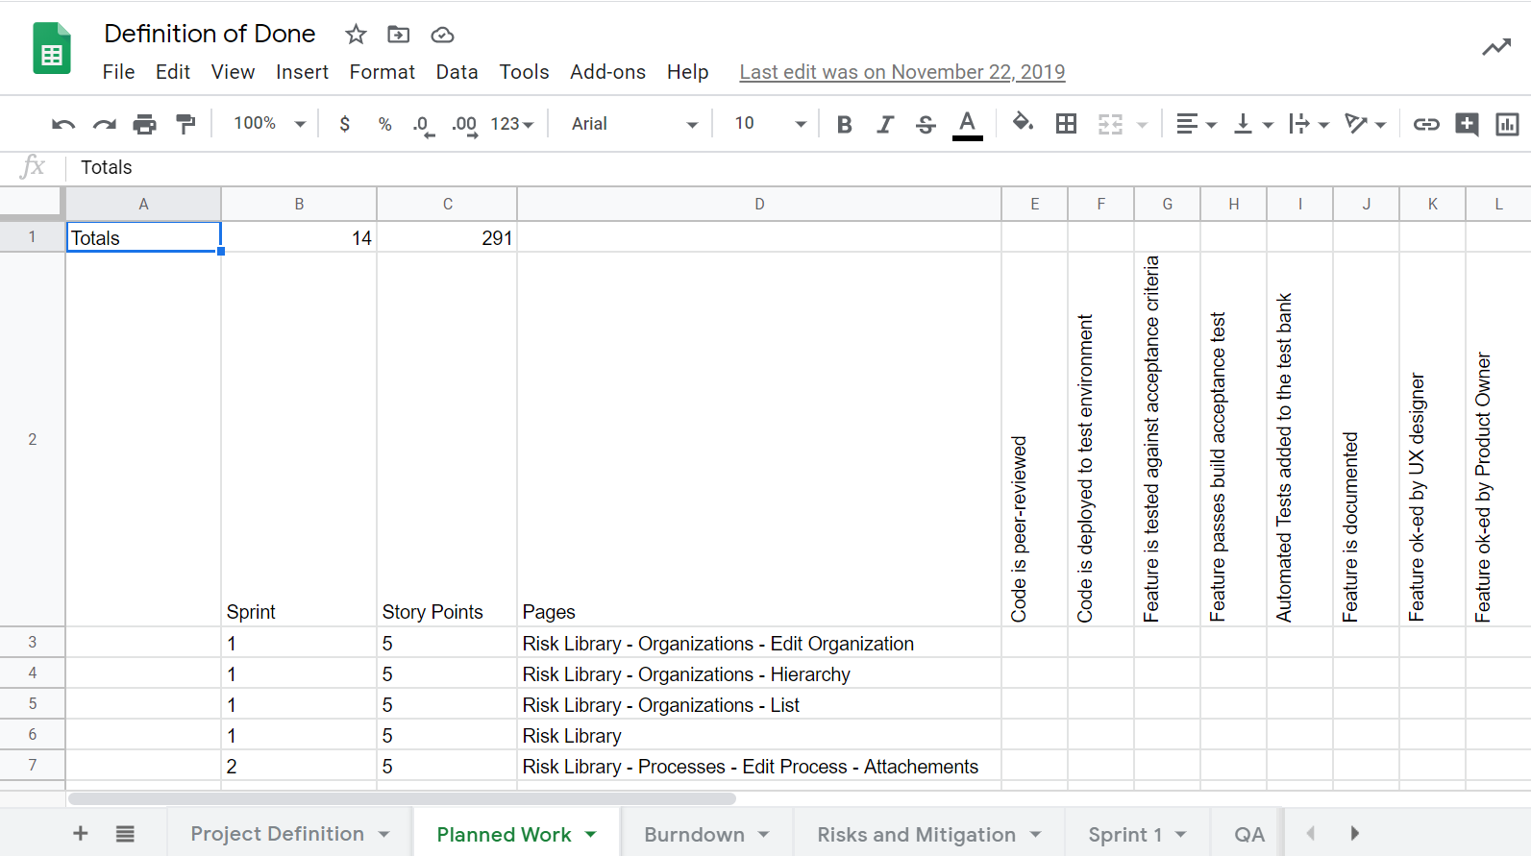
Scrum of Scrums
What is a burn down chart? SafePaaS Example

Slide 17
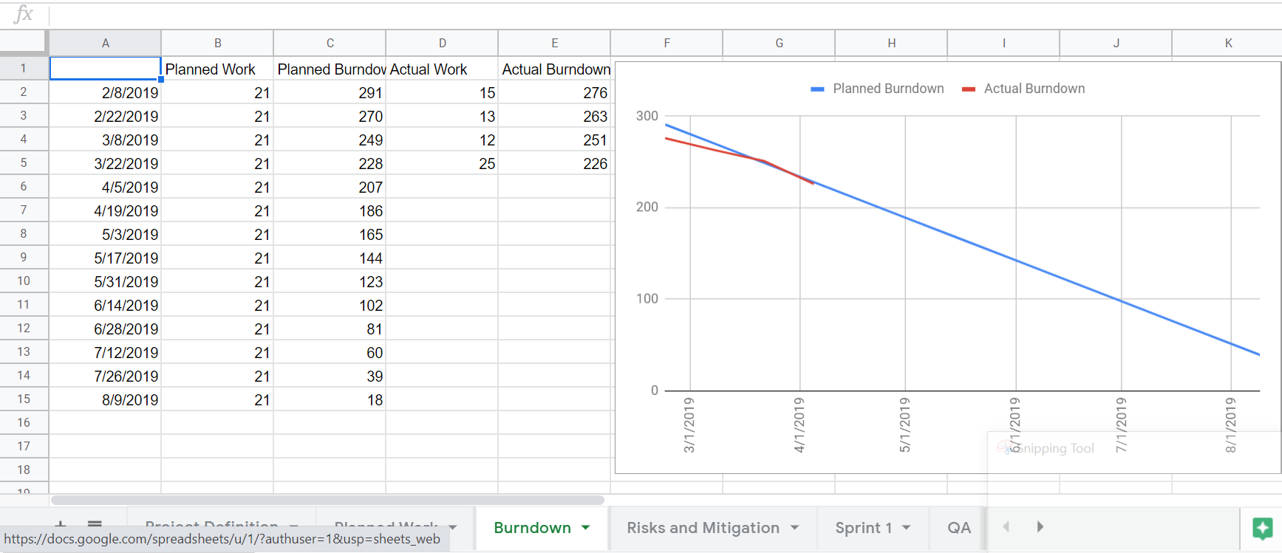
Scrum of Scrums
What is a burn down chart? SafePaaS Example

Slide 18
Next Lecture
Conducting Reviews.

